Slide 1
ClientFlow AI
CLIENTS
Enterprise Client Portal & Team Workspace Suite
Client • PM • Developer • Admin
From client feedback to completed work.
APP LAYER
React + TypeScript + FastAPI
COLLABORATE
ORGANIZE
AUTOMATE
ANALYZE
ACCELERATE
AI + DATA
Gemini + SQLite + analytics
Project presentation • 2026 • Yadhaesh27 / ClientFlow-AI

Slide 2
ClientFlow AI
ClientFlow AI
OVERVIEW
The problem ClientFlow AI solves
One workspace that connects client communication, delivery execution, approvals and project intelligence.
THE OLD WORKFLOW
THE CLIENTFLOW APPROACH
THE OUTCOME
Email + chat + spreadsheets + file sharing + separate task tools create fragmented project context.
A role-aware workspace connects feedback → tasks → files → approvals → reporting in one flow.
Faster handoffs, clearer accountability, measurable project health and better client visibility.
4
9+
0–100
1-click
Core roles
Major feature areas
Health score
AI feedback → task
2

Slide 3
ClientFlow AI
ClientFlow AI
USERS & ROLES
Designed around four real project roles
Each role gets a focused workspace instead of a one-size-fits-all dashboard.
CLIENT
PROJECT MANAGER
TEAM MEMBER
ADMIN
View progress Approve deliverables Comment & feedback Access files
Manage projects Assign tasks Track progress Generate reports
Update tasks Upload deliverables Collaborate View assignments
Manage organization Manage users System settings View analytics
ROLE-BASED ACCESS
MULTI-TENANT READY
CLIENT-FIRST UX
3

Slide 4
ClientFlow AI
ClientFlow AI
FEATURES
Feature ecosystem
The platform is more than a task board: it manages the full client-to-delivery lifecycle.
Client Portal
Project Workspace
Kanban Tasks
AI Assistant
Progress, files, feedback, approvals
Projects, health telemetry, members
Statuses, priority, story points, assignments
Feedback-to-ticket extraction, summaries, risks
Deliverables
Analytics
Executive Reports
Global UX
Versioning, sign-offs, feedback notes
Velocity, completion, client activity, CSAT
Completion, audit, workload, financial views
Ctrl+K search, shortcuts, dark/light themes
4

Slide 5
ClientFlow AI
ClientFlow AI
AI WORKFLOW
Gemini AI feedback-to-task engine
Turn unstructured client language into structured engineering work — with a human PM confirmation step.
01
02
03
04
05
CLIENT FEEDBACK
AI EXTRACTION
PM CONFIRMATION
KANBAN EXECUTION
REPORTING
“Please make the checkout faster and fix the mobile spacing.”
Identify actionable requests, context, priority and task candidates.
Project manager reviews and confirms before creating tickets.
Tasks enter the project board with ownership and status.
Completion, velocity and health metrics update the workspace.
HUMAN-IN-THE-LOOP AI
5

Slide 6
ClientFlow AI
ClientFlow AI
ANALYTICS
Deterministic project health engine
A transparent 0–100 score combines measurable delivery signals.
Health = 0.35 × Velocity + 0.25 × Safety + 0.20 × Approvals + 0.10 × Responsiveness + 0.10 × Activity
VELOCITY
SAFETY
APPROVALS
RESPONSE
ACTIVITY
35% Completed work / sprint pace
25% Overdue / blocked risk
20% Client approval progress
10% Client responsiveness
10% Recent workspace activity
EXPLAINABLE • REPEATABLE • DEMO-FRIENDLY
6

Slide 7
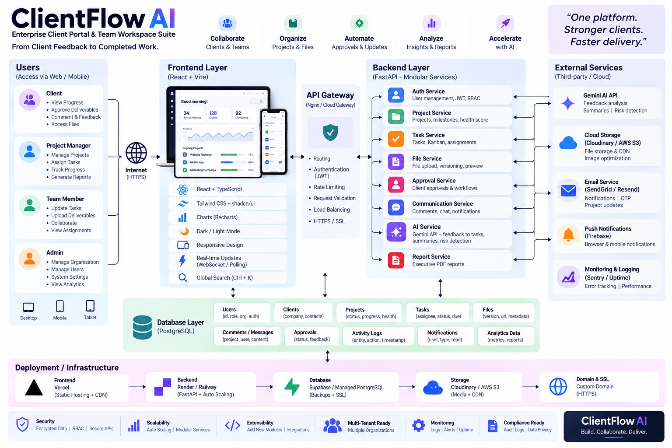
ClientFlow AI
ClientFlow AI
ARCHITECTURE
End-to-end system architecture
Presentation architecture showing the intended production-grade flow across users, frontend, API services, data and external integrations.
7

Slide 8
ClientFlow AI
ClientFlow AI
ARCHITECTURE
How the architecture works
A layered design keeps UI, business logic, persistence and integrations independently evolvable.
1 • EXPERIENCE
2 • API GATEWAY
3 • DOMAIN SERVICES
4 • DATA
5 • EXTERNAL
React + TypeScript Vite • Tailwind • Recharts Responsive client/admin views
Routing JWT authentication Validation • rate limiting
Auth • Projects • Tasks Files • Approvals • Communication AI • Reports
Current repository: SQLite SQLAlchemy ORM Domain entities + analytics
Gemini AI Cloud storage Email / notifications Monitoring integrations
Note: the supplied architecture visual shows PostgreSQL / cloud deployment as a production target; the public repository currently documents SQLite for the full-stack local setup.
8

Slide 9
ClientFlow AI
ClientFlow AI
TECHNOLOGY
Technology stack
Selected for fast iteration, clear separation of concerns and modern web UX.
FRONTEND
BACKEND
DATA
React 19 TypeScript Vite Tailwind CSS v4 Recharts
FastAPI Uvicorn Pydantic SQLAlchemy
SQLite Seeded demo data Relational domain model
AUTH
AI
DEPLOYMENT
JWT Password hashing Role-aware access
Gemini API Feedback extraction Summaries / risk assistance
Vercel Render / Railway Docker Compose config
9

Slide 10
ClientFlow AI
ClientFlow AI
DATA MODEL
Core data model
The domain model connects organizations, people, work, communication, approvals and audit history.
ORGANIZATION
USER
PROJECT
TASK
Tenant boundary Teams / workspace settings
Identity, role, auth Client / PM / Dev / Admin
Status, progress Health + members
Assignee, status Priority, due date, points
FILE / DELIVERABLE
APPROVAL
MESSAGE
ACTIVITY LOG
Version, URL, metadata Approval context
Status, feedback Timestamp / sign-off
Project/user content Communication history
Entity + action Timestamp / audit
10

Slide 11
ClientFlow AI
ClientFlow AI
ENGINEERING
Security, scalability & production readiness
The project is structured to evolve from a polished prototype toward a production SaaS platform.
SECURITY
SCALABILITY
NEXT HARDENING
• JWT authentication • Password hashing • Role-based access • API validation • Audit/activity records • HTTPS-ready deployment
• Modular FastAPI services • Separate frontend/backend • SQLAlchemy abstraction • Cloud deployment path • External storage integration • Multi-tenant design direction
• PostgreSQL at scale • Object storage • CI/CD + tests • Observability • Secrets management • Backups & recovery
PROTOTYPE → PRODUCTION ROADMAP
11

Slide 12
ClientFlow AI
ClientFlow AI
DEMO
Recommended live-demo storyline
A 5-minute story that proves the platform instead of just showing screens.
1
2
3
LOGIN
CLIENT PORTAL
AI
Enter as Client / PM / Developer
Open project → review progress → leave feedback
Send feedback → extract task candidates
4
5
6
KANBAN
APPROVAL
REPORT
PM confirms → assign → move task through workflow
Upload/version deliverable → client signs off
Show health score → analytics → executive report
12

Slide 13
ClientFlow AI
ClientFlow AI
IMPACT
Why this project stands out
ClientFlow AI connects product UX, workflow automation and explainable project intelligence.
CLIENT EXPERIENCE
TEAM EXECUTION
A dedicated portal makes approvals and feedback easy.
Kanban + assignments connect client requests to delivery.
AI VALUE
MANAGEMENT
Gemini reduces the gap between natural language and structured work.
Health scoring and reports turn activity into decision support.
BUSINESS VALUE
EXTENSIBILITY
One shared workspace reduces tool fragmentation and status chasing.
Modular services allow future integrations and production scaling.
BUILD. COLLABORATE. DELIVER.
13

Slide 14
ClientFlow AI
One platform. Stronger clients. Faster delivery.
CONNECT
AUTOMATE
MEASURE
Clients ↔ Teams ↔ Projects
Feedback ↔ AI ↔ Tasks
Health ↔ Analytics ↔ Reports
GitHub: github.com/Yadhaesh27/ClientFlow-AI
Thank you • Questions?

